Slide 1
Income Classification
CSE454 - Project
Abdurrahman Bulut
1901042258

Slide 2
Content
Problem Definition
Data Cleaning
Exploratory Data Analysis(EDA)
Feature Encoding,
Boxplot
Outlier Detection
Sampling
Principal Component Analysis (PCA)
Logistic Regression Model
Other Classification Models
Conclusion
Resources

Slide 3
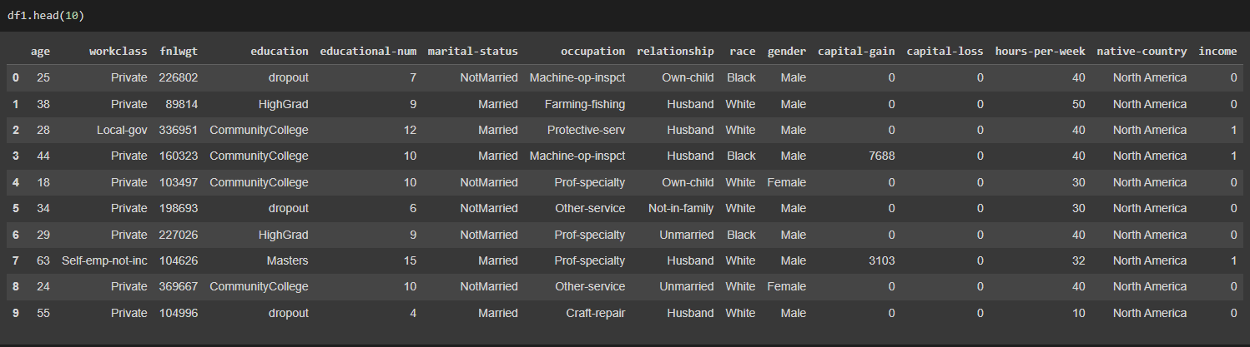
Problem Definition
Predict whether an individual earns more than $50,000 per year or less.

Slide 4
Data Cleaning
Fixed Nan values in the dataset.
Duplicated elements are removed.
Income feature classified with 0’s and 1’s.

Slide 5
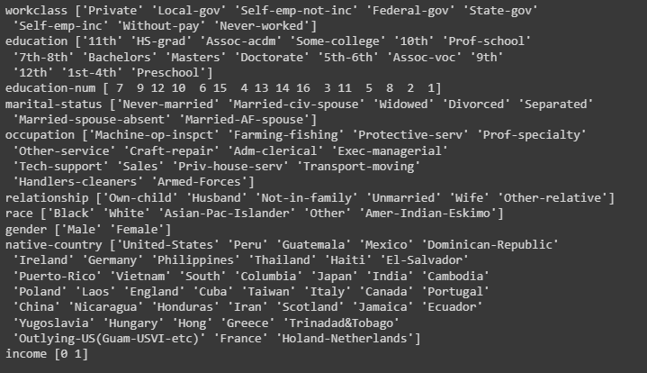
Data Cleaning
The Education, native country and marital status categories are simplified.
the countries by continents in native-country.

Slide 6
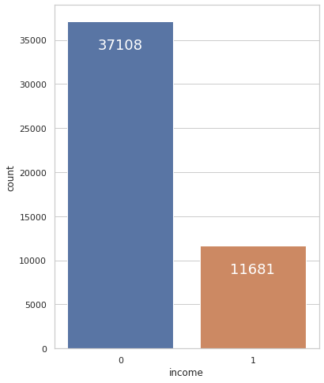
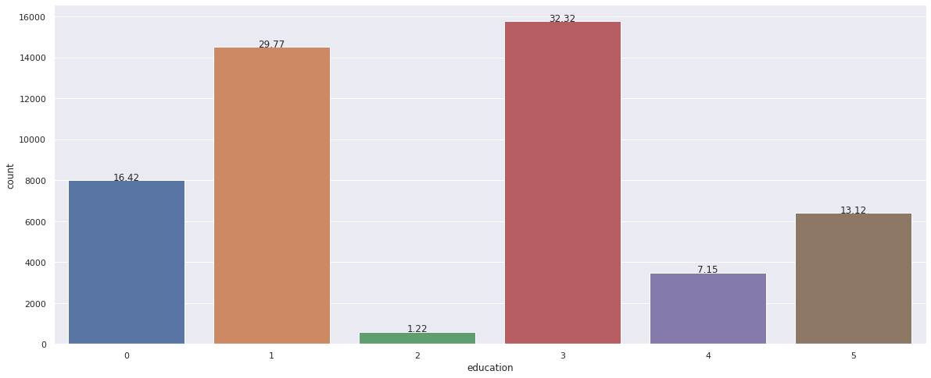
Exploratory Data Analysis
Income Classification Graph
Education levels

Slide 7
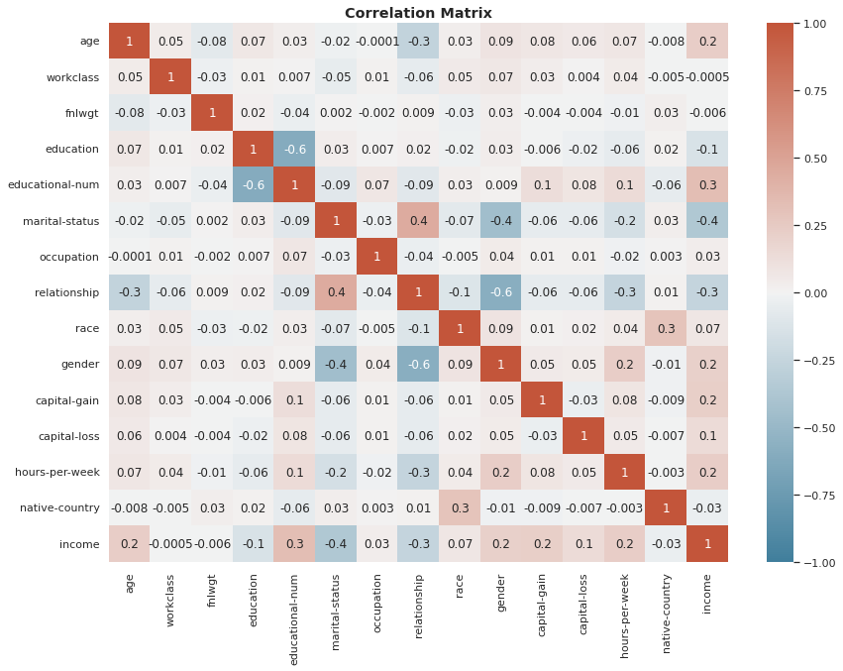
Exploratory Data Analysis

Slide 8
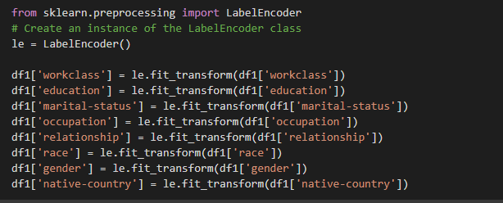
Feature Encoding
For example: [“male”, “female”] will be [0, 1].

Slide 9
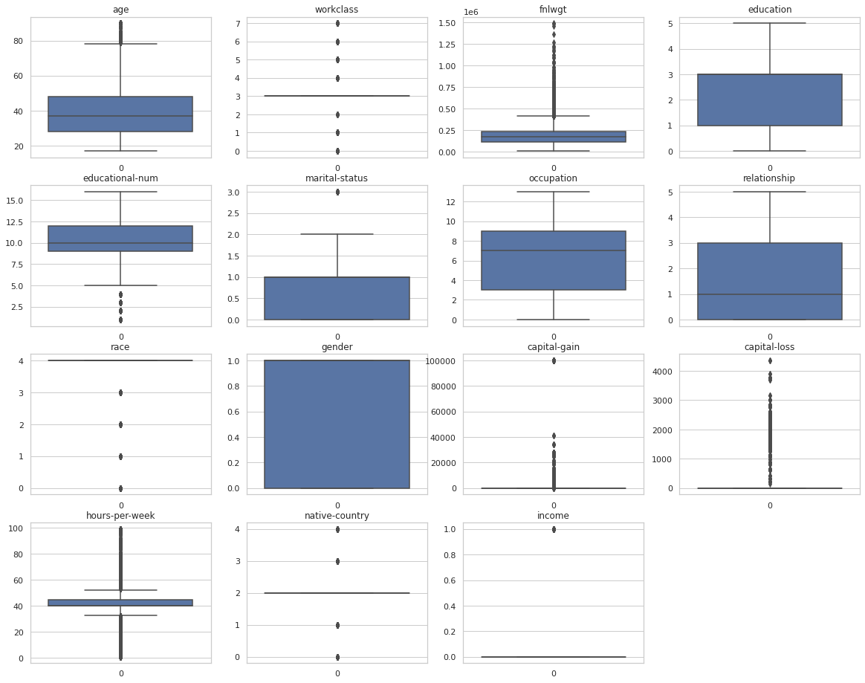
Boxplot

Slide 10
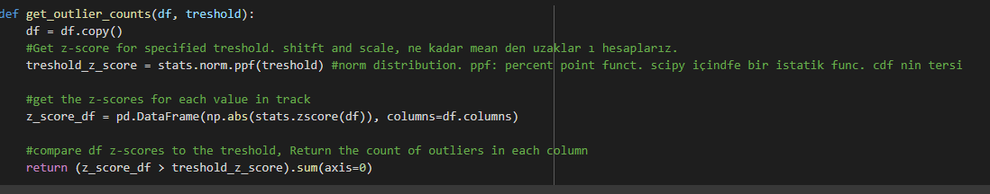
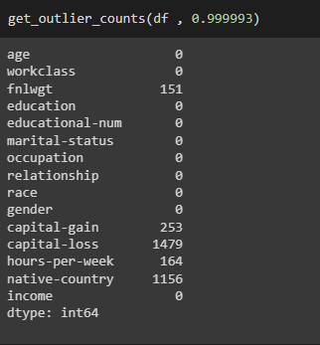
Outlier Detection

Slide 11
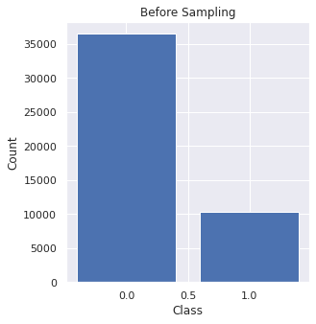
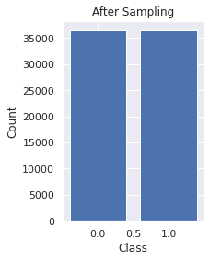
Sampling

Slide 12
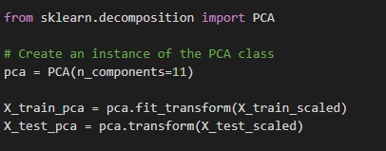
Principal Component Analysis - PCA

Slide 13
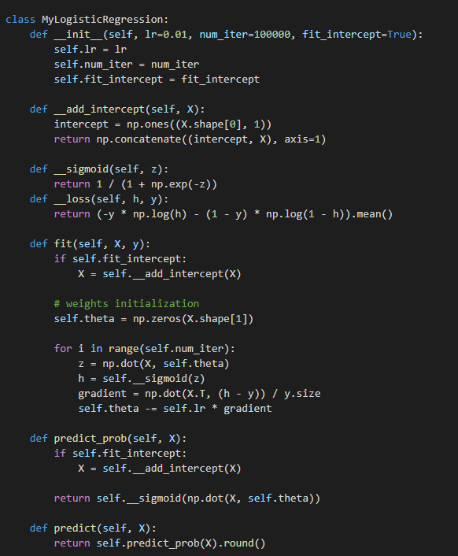
Logistic Regression Model

Slide 14
Other Classification Models
Algorithms | Best Accuracy
LGBM | 89.76%
XGBoost | 88.06%
Decision Tree | 85.55%
SVM | 82.01%
Random Forest | 89.35%

Slide 15
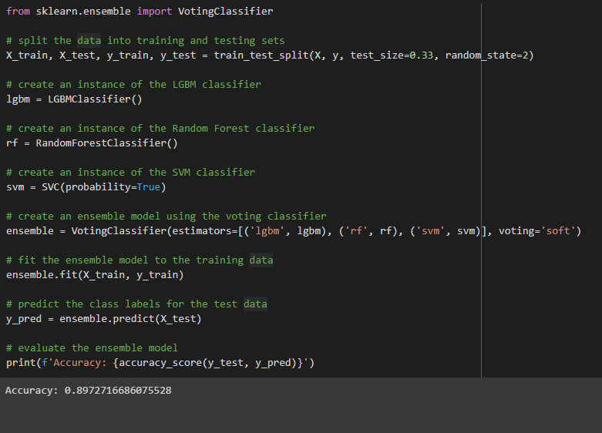
Ensemble Model

Slide 16
Conclusion
The LGBM classifier is a suitable model for this problem.
Outlier detection increased success in all models.
The effect of PCA and sampling methods varied from model to model.

Slide 17
Resources
“Adult Income Dataeset”, http://archive.ics.uci.edu/ml/datasets/Adult, 1996
“A logistic regression from scratch”, “Dennis Bakhuis”, https://towardsdatascience.com/a-logistic-regression-from-scratch-3824468b1f88, 2020
“PCA ( Principal Component Analysis) Temel Bileşenler Analizi”, “Gülcan Öğündür”, https://medium.com/@gulcanogundur/pca-principal-component-analysis-temel-bile%C5 %9Fenler-analizi-bf9098751c62, 2020
“Sampling Techniques— Statistical approach in Machine learning”, ”Suresha HP”, https://medium.com/analytics-vidhya/sampling-statistical-approach-in-machine-learning- 4903c40ebf86, 2021
“Scikit-learn developers”, https://scikit-learn.org/stable/modules/outlier_detection.html

Slide 18
Thank You

